Slide 1


!Chess
Rodrigo Valente
Teresa Gamito

Slide 2
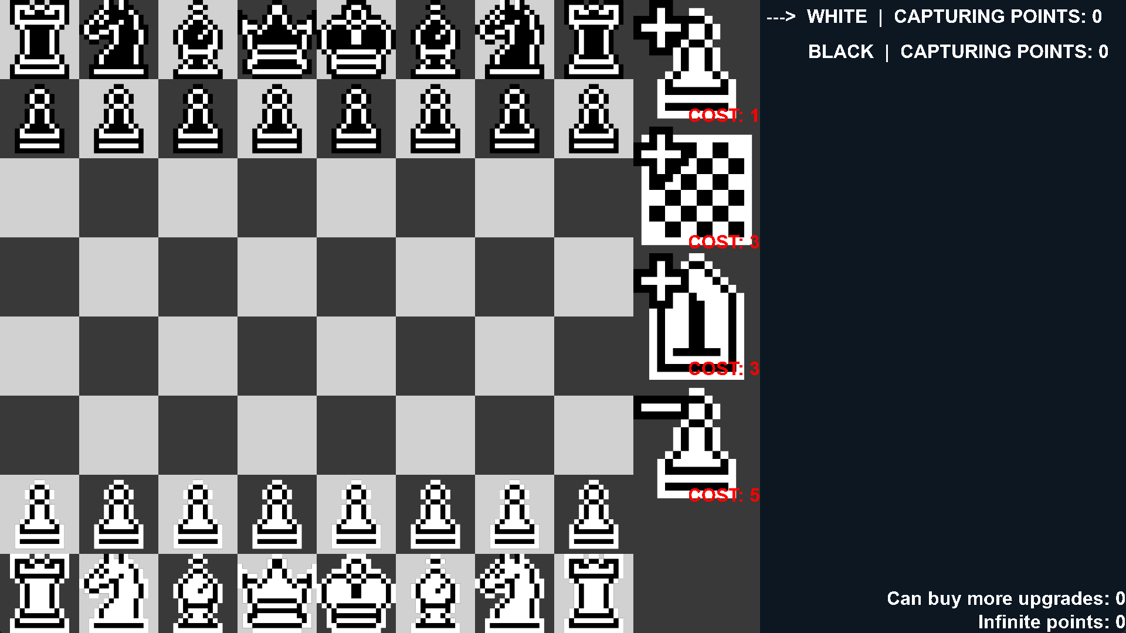
Overview
2D top-down
Local 1 vs 1
Strategy
Inspired by chess
Windows / Linux PC
Prototype
Notes:
2

Slide 3
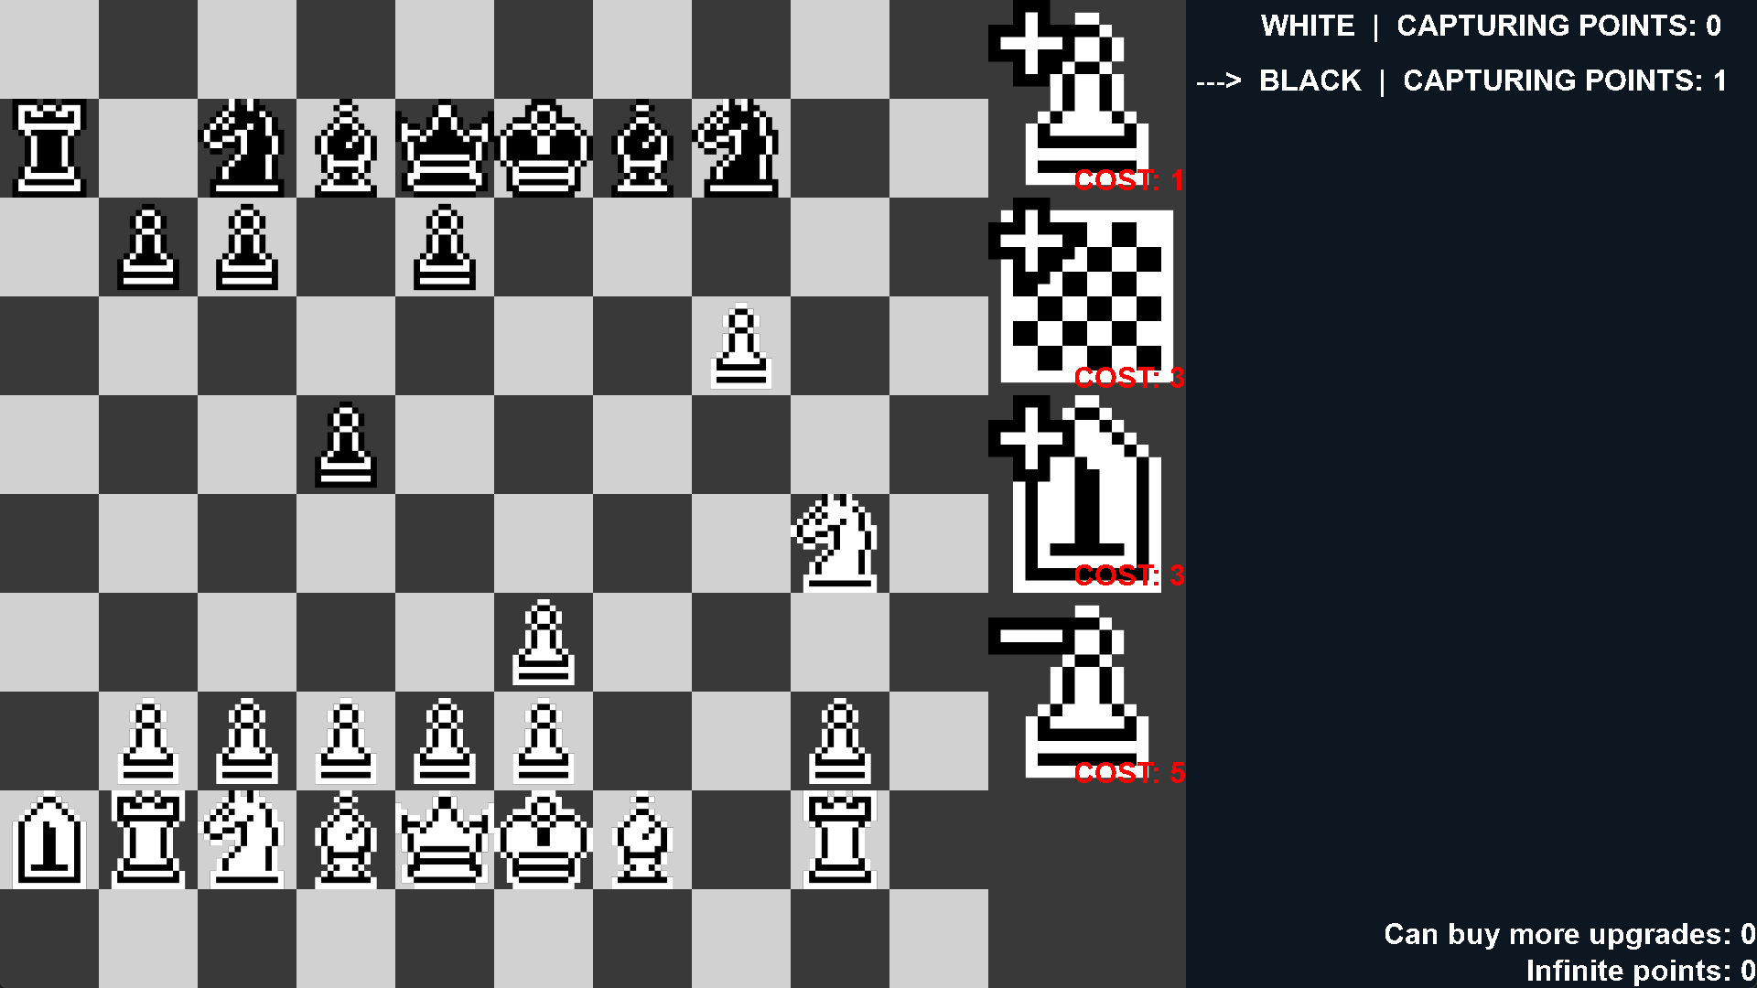
Basic Gameplay
Start as regular chess
Gain points by capturing enemy pieces
Modify the game by using a shared upgrade tree
Each turn a player can move a piece or buy an upgrade
The game becomes gradually more chaotic
Start of game
Mid-game
Notes:
3

Slide 4
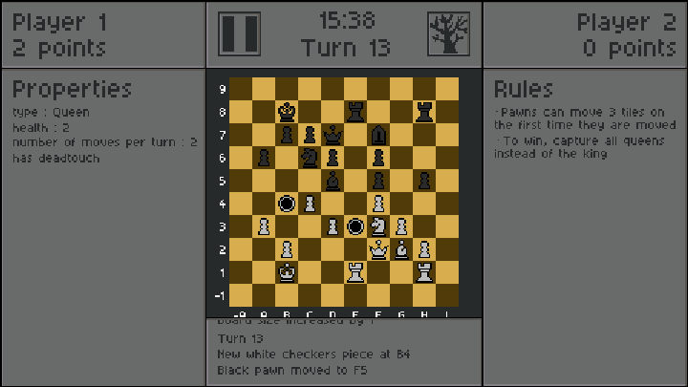
UI
Properties
Rules
History of actions
Player’s information
Board / Upgrade tree
Early mockup
Notes:
4

Slide 5
Upgrade tree
Adds a Pawn
Shared by both players
Players get points by capturing pieces
Spend the points on the tree to modify the game
Each node can only be purchased once
Expands the board
Adds a Lance
Both players sacrífice a
piece

Slide 6
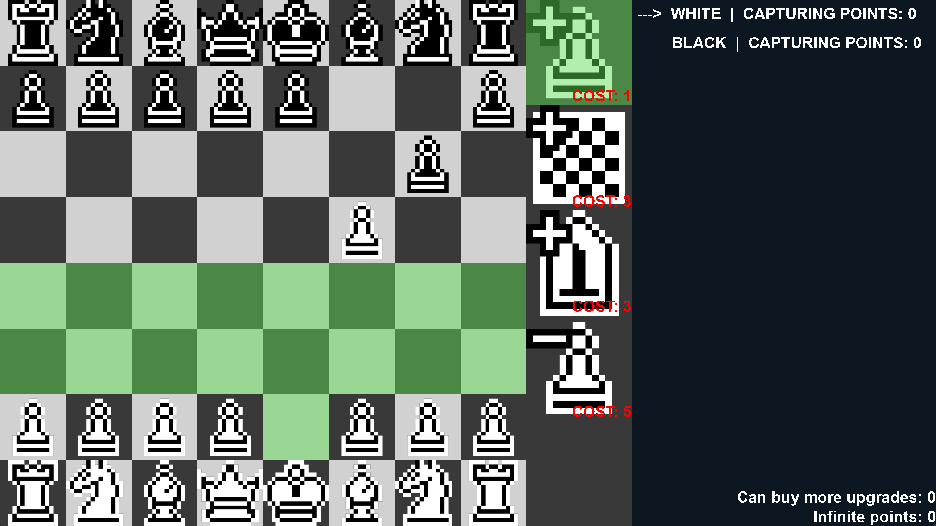
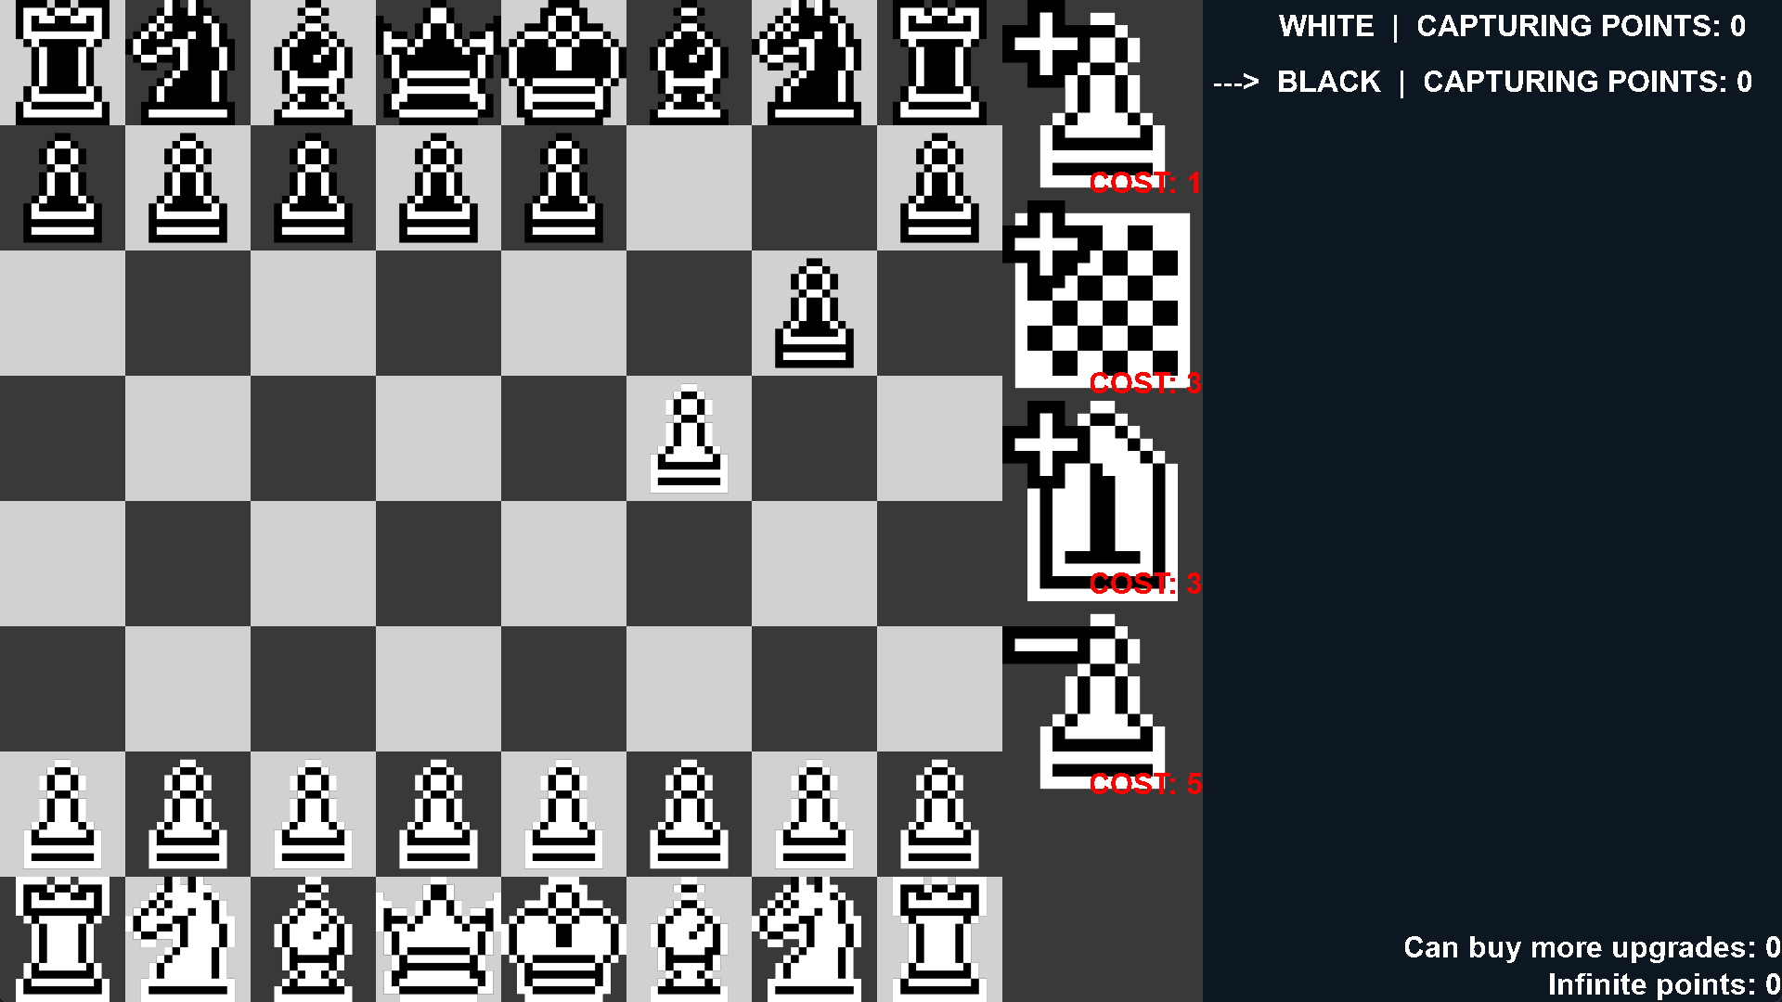
Add pieces to the board
The piece can only be placed on the player’s half of the board and on a clear tile
Notes:
6

Slide 7
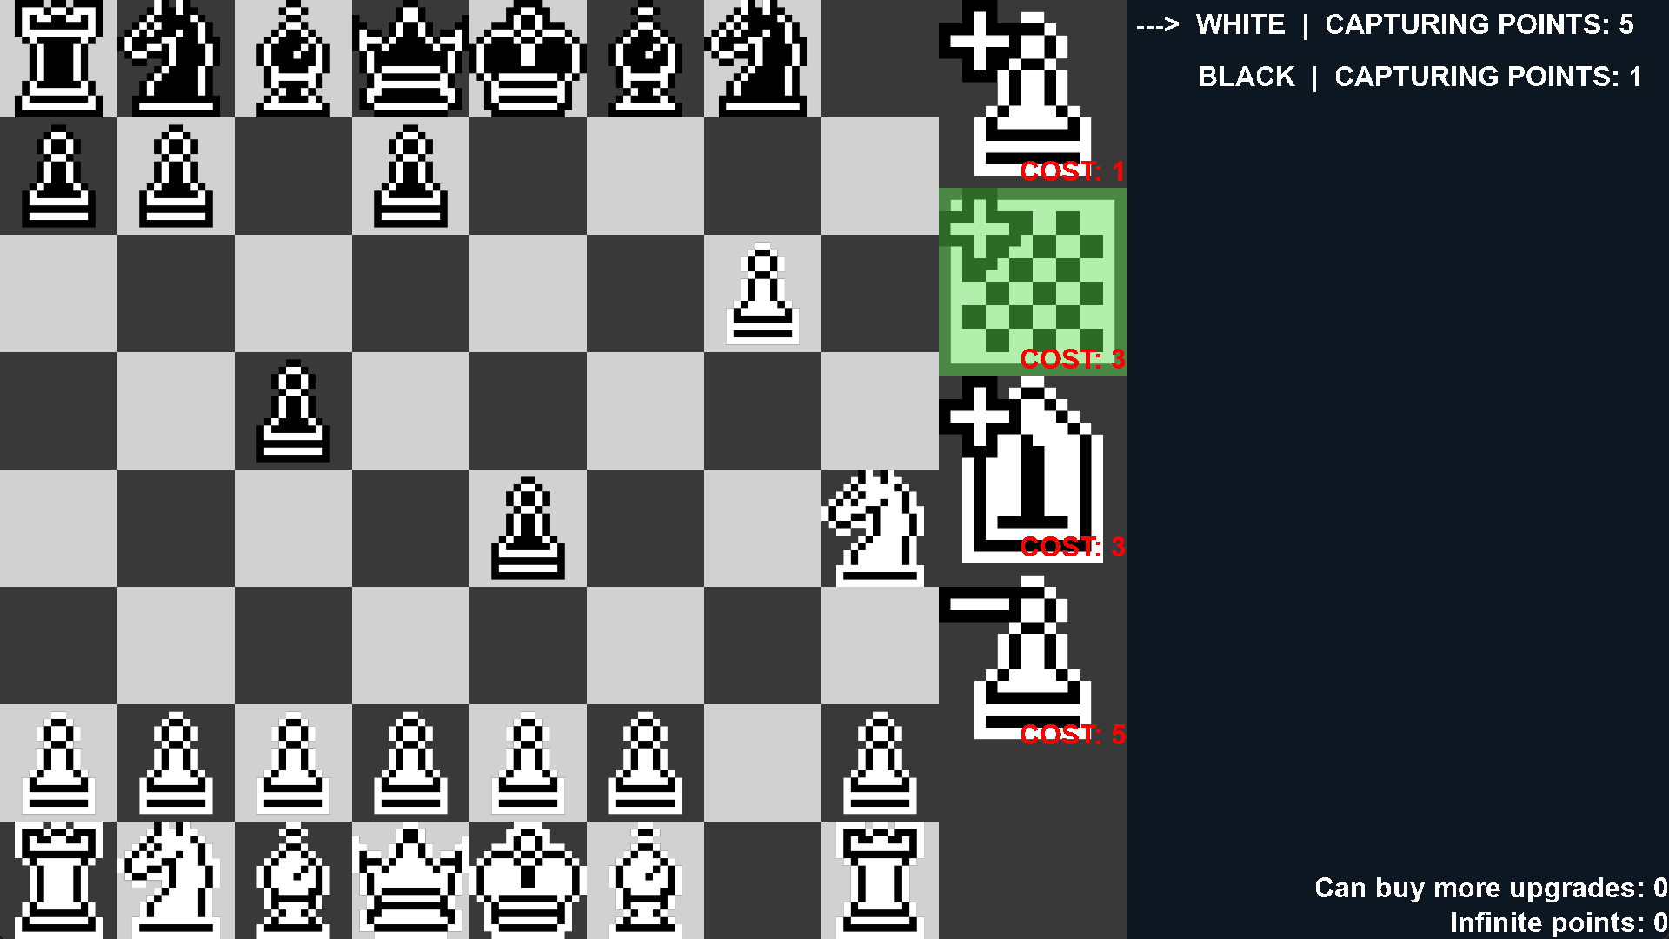
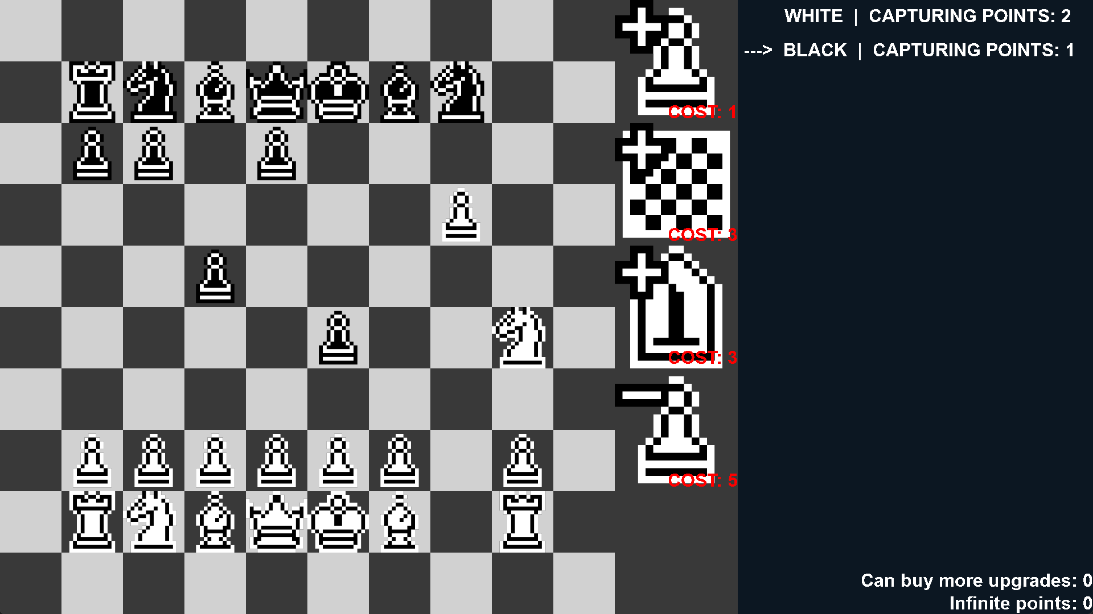
Change the size of the board
Adds a tile to each side of the board

Slide 8
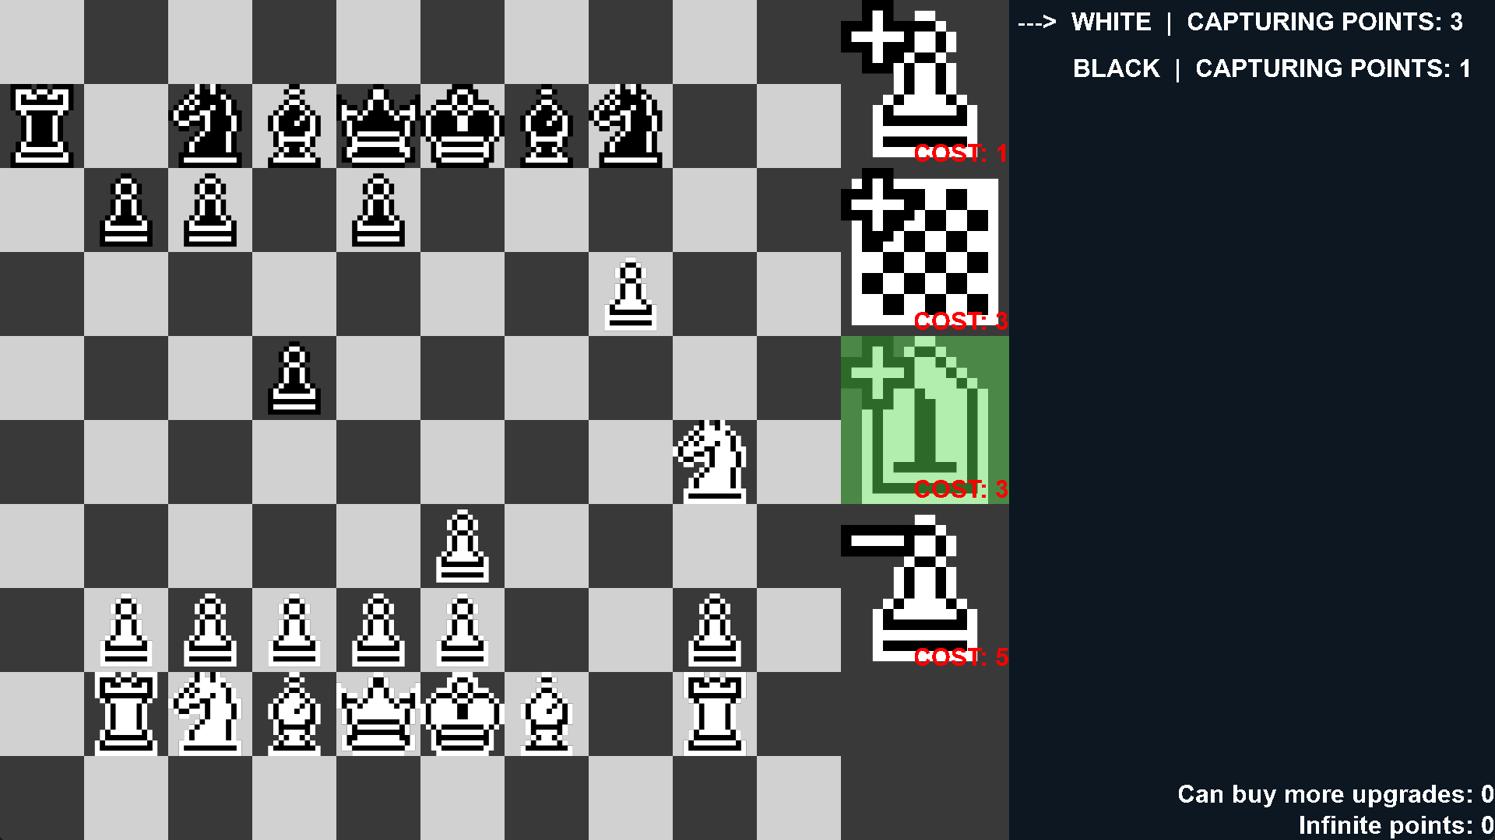
Adds pieces from other games
The Lance from Shogi moves only forward any number of tiles
Notes:
GONNA trim these
8

Slide 9
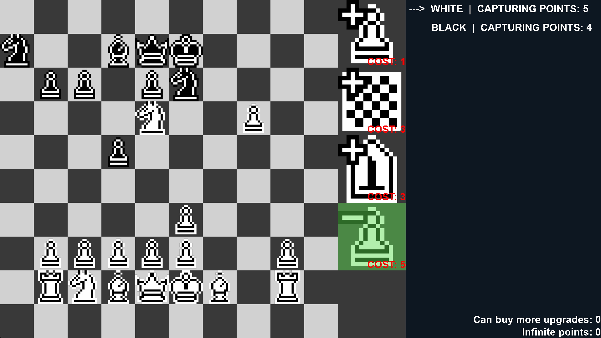
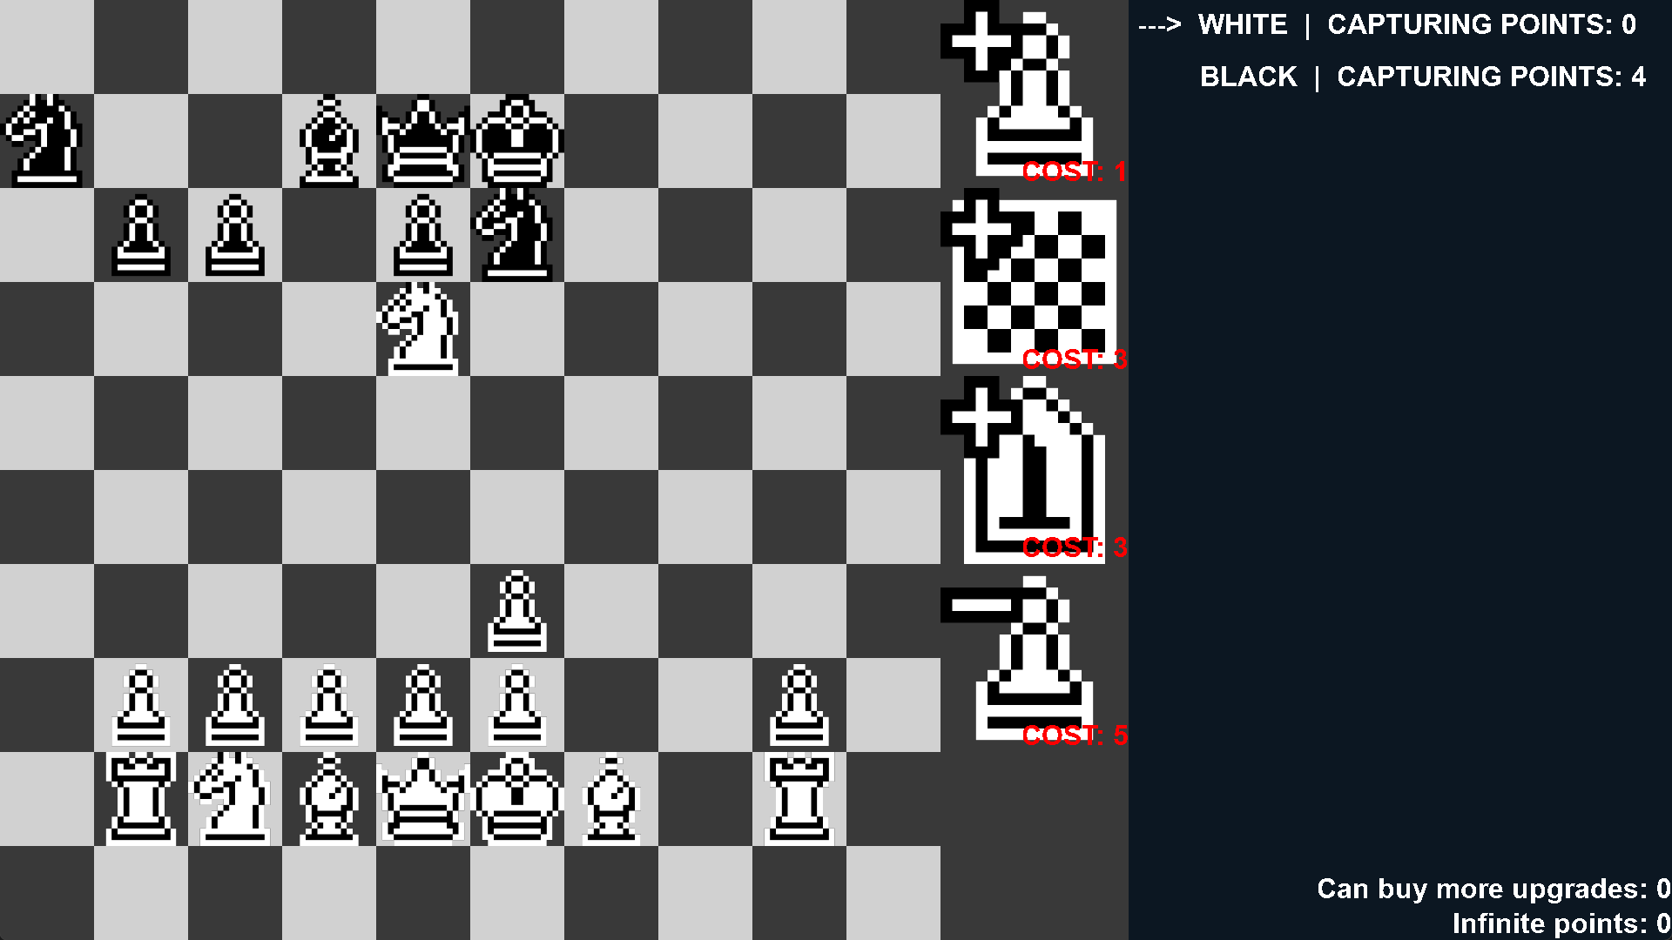
Sacrifice pieces
Each player choses one piece to be sacrificed, starting with the player that bought the node

Slide 10
Buff
Modifies the properties of pieces / tiles to boost them
Promotion
Gain control of enemy pieces
“Promote a pawn”
“Add deathtouch to a piece”
Notes:
Editei isto
10

Slide 11
Debuff
Modifies the properties of pieces / tiles to nerf them
Unpromote pieces
Disable pieces
Create wall tiles that block the path
“Choose an opponent’s piece. That piece is now disabled”
“Add poison to a tile”
Notes:
Ainda tenho tanto que fazer ;.; btw o background….
11

Slide 12
Ruling
Adds passives to the game
Changes the rules of the game
“To win, capture all of the opponent’s queens instead of the king”
“Pawns can’t capture other pieces”

Slide 13




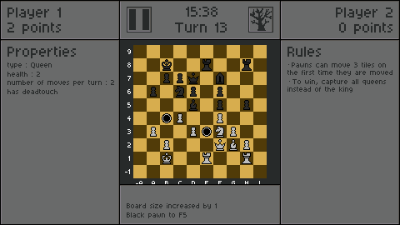
Art
2D pixel art
Simple textures
Arcade like

Slide 14
Audio
Arcade-like music
Blues-like music
Inspired by Balatro

Slide 15
Prototype Gameplay
Notes:
;-;

Slide 16
Thank you
Notes:
;-;

